Slide 1
Creating Accessible Presentations
An illustration of the NCDAE accessible PowerPoint presentation creation “cheat sheets”

Slide 2
Use Outline View
From View, click Outline View
Use tab and enter keys to add spacing
Work from this (outline view) screen to employ a proper hierarchical structure

Slide 3
Proper Hierarchical Structure
Notes:
As you add text to your slides, keep in mind that you should always follow a consistent hierarchy of font size to make your slides easy to parse visually. Generally speaking, higher level text should be larger and no text should be used that is smaller than 24-28 points.

Slide 4
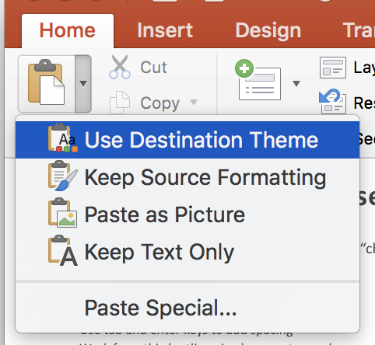
Use Destination Theme to format pasted text
From Home, Click Paste arrow
Click Use Destination Theme

Slide 5
Use Distinctive Slide Titles
Best practice
Slide Titles, repetitive
Slide Titles, distinctive
Process
Process
Process
Process – beginning
Process – middle
Process - end
Non-descriptive

Slide 6
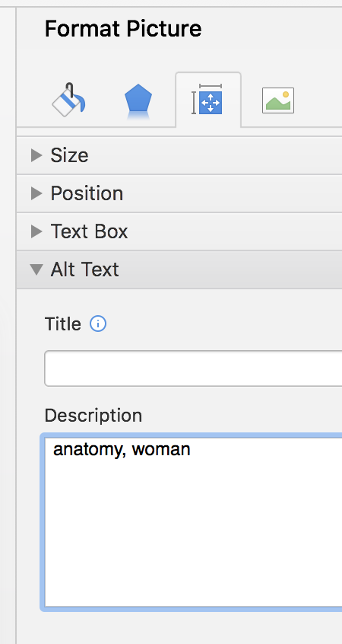
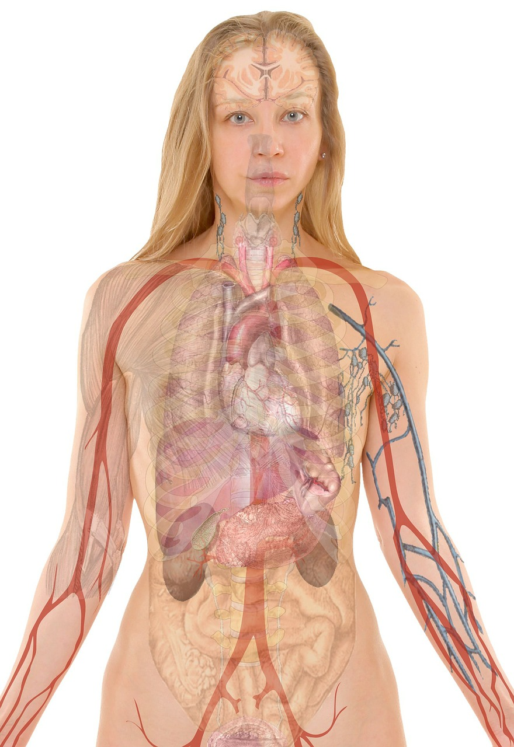
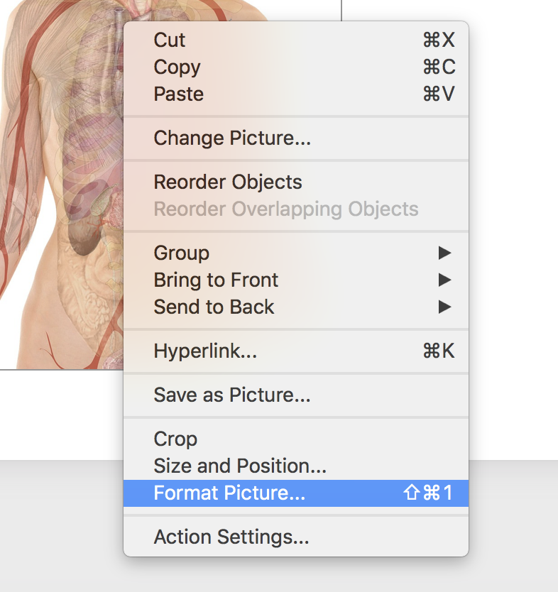
Insert alt(ernative) text in images
Right click on image
Insert brief explanation of image

Slide 7
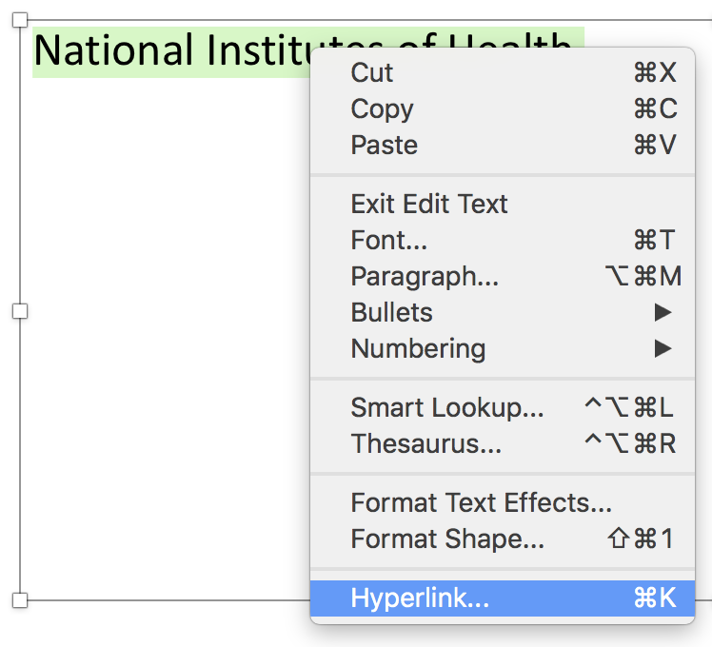
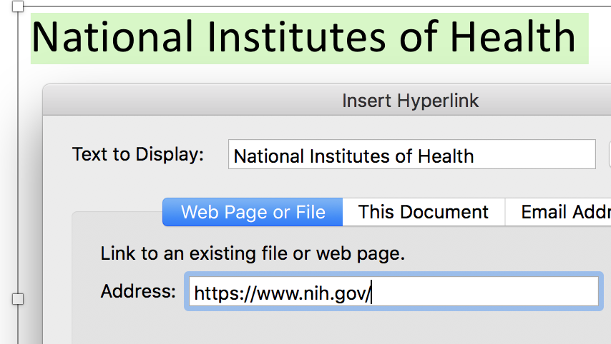
Name Hyperlinks Meaningfully
National Institutes of Health
Highlight text; right click
National Institutes of Health

Slide 8
Consider Your Colors: Contrast
Low Contrast
High Contrast
https://webaim.org/resources/contrastchecker/
Notes:
Low contrast images, text, and themes can make your presentation difficult for your audience to read.

Slide 9
Consider Your Colors: Connoting meaning
Do:
Don’t
Label lines
Rely solely on color to connote meaning
Use distinctive line styles
Charts from Penn State Accessibility: http://accessibility.psu.edu/images/charts/
Notes:
Make sure that you aren’t relying on color alone to convey information as this can be inaccessible to colorblind users and others with visual impairments.

Slide 10
Creating Lists
Use bullets for unordered list (e.g., ingredients list)
4 eggs
1/4 cup milk
salt and pepper, as desired
2 tsp. butter
Use numbers for ordered list (e.g., cooking instructions)
Beat eggs, milk, salt and pepper in bowl.
Heat butter in hot skillet.
Pour egg mixture into skillet.
Gently pull eggs with spatula, forming large soft curds till firm.
Remove from heat.
Serve immediately.

Slide 11
Caption & Audio Describe Video
Caption video content (check accuracy)
Provide time-synchronized transcription, if needed
Use audio description, if needed

Slide 12
Keep It Simple
Use readable font size and style
Avoid densely packed text or visuals
Explain acronyms, jargon, and idioms
Avoid ALL CAPS
Avoid use of distracting animations or transitions

Slide 13
Accessibility Checker
Click on Review
Click on Check Accessibility
Make corrections as indicated

Slide 14
Resources
NCDAE MS Office cheatsheets
http://ncdae.org/resources/cheatsheets/
WebAIM
https://webaim.org/

